Slide 1
CS 340 Golf App
Created by: Raul Luna, Chris Thomas, Diana Roberts

Slide 2
GOALS
We wanted to create an application to help the average golf perform to their full potential on any given day on the course. With features like course management, professional tips and managing scorekeeping and stat tracking, our application can let a golfer know their strengths and weaknesses on the course from a variety of skill levels by using our application. Stat performance then can be uploaded to an online clubhouse community where golfers can interact and compete with tens of other players worldwide!!!

Slide 3
FEATURES
Individual Profile
Handicap
News Feed
Starting a New Round
Basic Rules of the Game
Friends / Social Connection (Query lookup for friends)

Slide 4
Individual Profile
Basic Information
  Contact Information
Product Information
  What’s in my Bag?
    Current clubs, balls, shoes, gloves, etc that are in-play

Slide 5
Implementing a Database
Individual Profile
  Contact Information
  Product Information
    Current Equipment
  Current Handicap

Slide 6
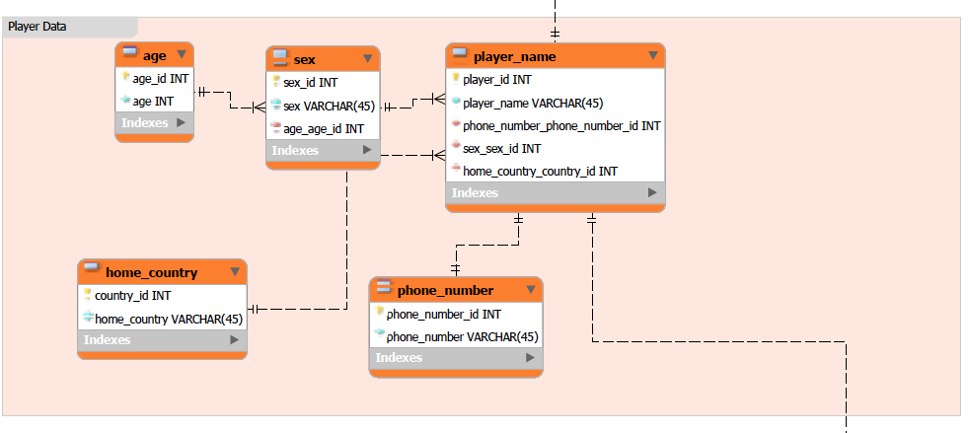

Slide 7
Handicap
Handicap determines the overall potential any individual that plays the game
Range: +9.9 (Tiger Woods) - 36.4 (Hardik Prajapati)
At least eight scores must to be posted into the database to give a true current handicap
  Best eight overall scores posted and/or significance of score
  Updates every two weeks

Slide 8
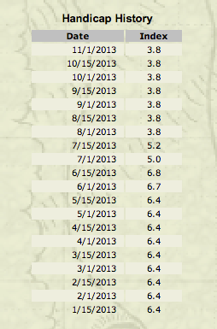

Slide 9


Slide 10
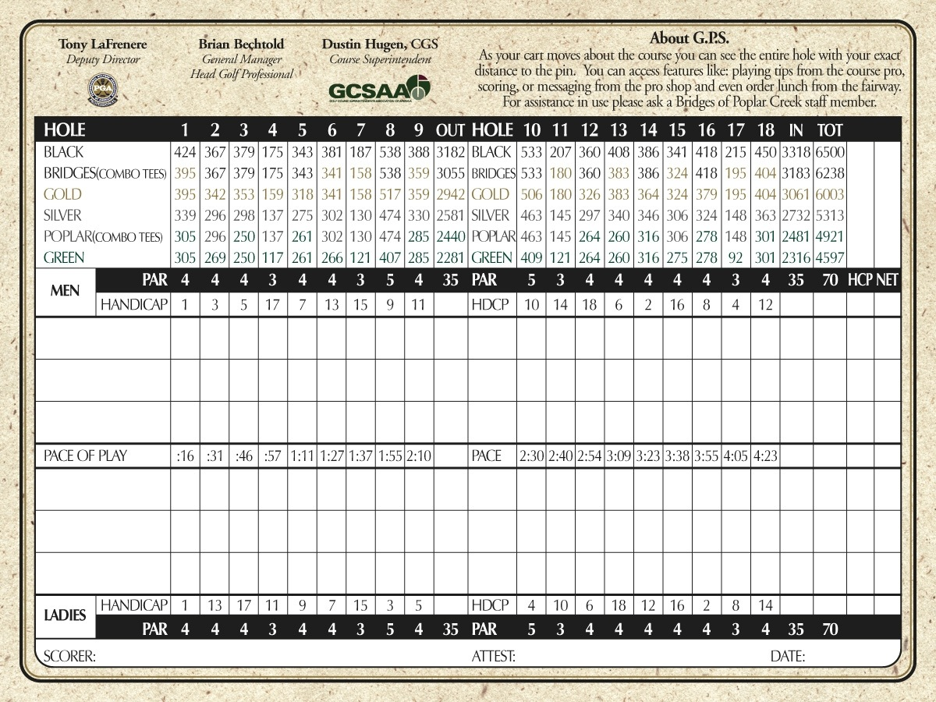

Slide 11
News Feed
Golf Channel
  PGA Tour
  LPGA Tour
  Web.com Tour
ESPN
NBCSports

Slide 12
Start a New Round
Selecting a course to play
  Selecting which tees to play from as well
Stat-Tracking ( # fairways hit, # GIR, # putts, # Up and Downs, etc…)
Scorecard

Slide 13
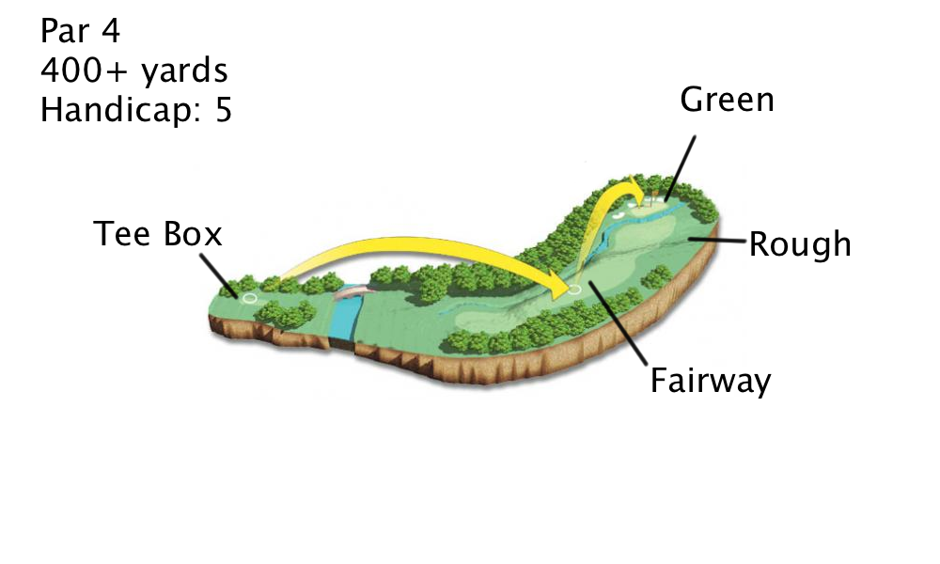

Slide 14
Implementing a Database
Course Directory
  Search for Course Near Me
  Search Entire Course Database
  My Favorite Courses
  Scorecard ( Par, Yardage, Rating, Slope)

Slide 15
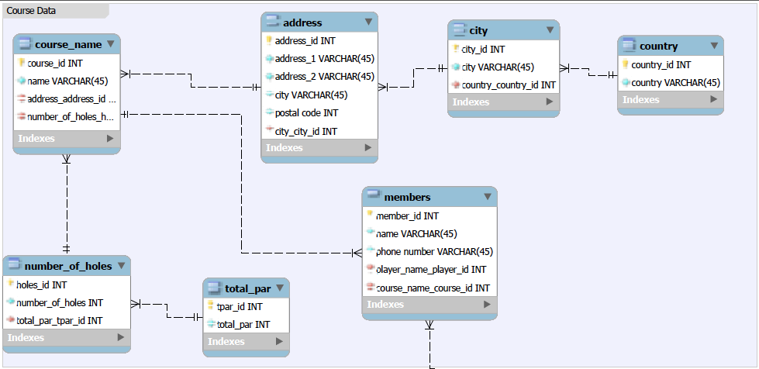

Slide 16
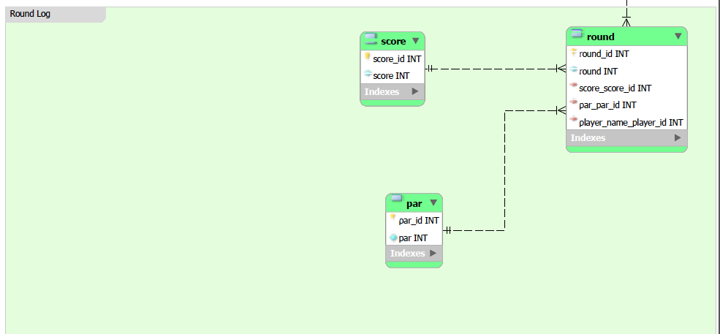

Slide 17
Rules of the Game
United States Golf Association (USGA) Rules and Decisions
Pros & Amateurs play through the same obstacles unlike hitting a 90 mph fastball at Fenway Park, driving 150+ mph at Daytona 500, getting tackled by Ray Lewis (last year), etc…

Slide 18
Friends / Social Connections
App Community
Instagram
Facebook (duh!)
Twitter
Snapchat

Slide 19
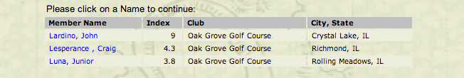
App Community Implementation

Slide 20
CS 340 Golf App
Questions / Comments / Concerns???

